Slide 1


Capstone Project
Publication
Notes:
Hi everyone,
My name is Shiraj Ahmad,
and I'm a mentor here for data science.
In this session, I'll be explaining Power BI's Capstone Project: Publication
First, congratulations on completing Excel, SQL, and Power BI.
After completing this Capstone Project, you'll be job-ready!
So, let's get started.

Slide 2
Overview
The database we will be using is the Publication database.
It is a fictitious database designed to represent the data management needs of a publishing company.
It consists of several tables capturing different aspects of the publishing process, including authors, titles, sales, stores, employees, publishers, and discounts. This database provides valuable insights into the publication industry and serves as an educational resource for learners and professionals interested in database management and analysis.
Notes:
The database we will be using is the Publication database.
It is a fictitious database designed to represent the data management needs of a publishing company.
It consists of several tables capturing different aspects of the publishing process, including authors, titles, sales, stores, employees, publishers, and discounts. This database provides valuable insights into the publication industry and serves as an educational resource for learners and professionals interested in database management and analysis.

Slide 3

Problem Statement
Objective
Analysis Scope
Goal
Insights & Recommendations.
Report & Presentation
Notes:
Problem Statement for Power BI Dashboard using Sample Publication Database:
Objective: The objective of this project is to create a comprehensive Power BI dashboard utilizing the Sample Publication Database. The dashboard aims to provide valuable insights into the publishing company's book sales performance, author royalties, and store distribution, enabling data-driven decision-making and strategic planning.
Analysis Scope: The analysis will focus on various aspects of the publication process, including book sales, author contributions, store performance, and the impact of discounts. It will encompass historical sales data, author royalties based on royalty schedules, and distribution data from multiple bookstores.
Goal: The primary goal of this Power BI dashboard is to offer a holistic view of the publishing company's operations. It will provide actionable insights to optimize book sales, enhance author collaboration, improve store distribution strategies, and identify opportunities for growth and efficiency.
Insights & Recommendations: The Power BI dashboard will generate valuable insights into the top-selling book titles, bestselling genres, and sales trends over time. It will analyze the performance of different bookstores, identify bestselling authors, and calculate author royalties based on royalty schedules. Additionally, it will recommend effective discount strategies to boost book sales and customer engagement.
Report & Presentation: The final deliverable will consist of a detailed report describing the data sources, data modeling methodologies, and data cleansing processes used in creating the Power BI dashboard. The report will also include a step-by-step guide on how to interpret the insights and use the dashboard for decision-making. The presentation will showcase the key findings, visualizations, and actionable recommendations derived from the dashboard's analysis.
The Power BI dashboard, along with the report and presentation, will serve as a powerful tool for the publishing company's stakeholders. It will empower them to make informed decisions, optimize book sales strategies, foster author collaborations, and enhance the overall business performance in the competitive publishing landscape.

Slide 4


Significance
Valuable insights
Improvement focus
Evaluation of effectiveness
Trend identification
Comprehensive understanding
Notes:
Significance of Power BI Dashboard using Sample Publication Database:
Valuable Insights: The Power BI dashboard using the Sample Publication Database provides valuable insights into the publishing company's performance and operations. It presents data-driven analytics on book sales, popular genres, and author contributions. Stakeholders can gain a deeper understanding of customer preferences, bestselling titles, and effective marketing strategies.
Improvement Focus: The dashboard helps the publishing company focus on areas that require improvement. By analyzing sales trends, store distribution, and discount effectiveness, the dashboard identifies opportunities to optimize sales and increase revenue. It enables the company to refine its marketing and distribution strategies to better cater to customer demands.
Evaluation of Effectiveness: The dashboard facilitates the evaluation of various aspects of the publishing business. It assesses the effectiveness of discounts on sales, the impact of different bookstores on revenue, and the success of marketing campaigns. With this evaluation, the company can make data-driven decisions to enhance its overall effectiveness and profitability.
Trend Identification: Using historical sales data and author royalties, the dashboard identifies trends in book sales over time. It helps identify seasonal patterns, bestselling genres in specific periods, and the success of certain authors or book titles. This trend identification empowers the company to plan for future publications and marketing efforts more effectively.
Comprehensive Understanding: The Power BI dashboard offers a comprehensive understanding of the publishing company's operations. By presenting data on book sales, author royalties, and store distribution in one centralized platform, stakeholders can have a holistic view of the business. This comprehensive understanding enables better decision-making and a more cohesive strategy across all aspects of the publishing process.
In summary, the Power BI dashboard using the Sample Publication Database is significant for the publishing company as it provides valuable insights, focuses on improvement opportunities, evaluates effectiveness, identifies trends, and offers a comprehensive understanding of its operations. By leveraging these insights, the company can make informed decisions, optimize performance, and stay competitive in the dynamic publishing industry.

Slide 5
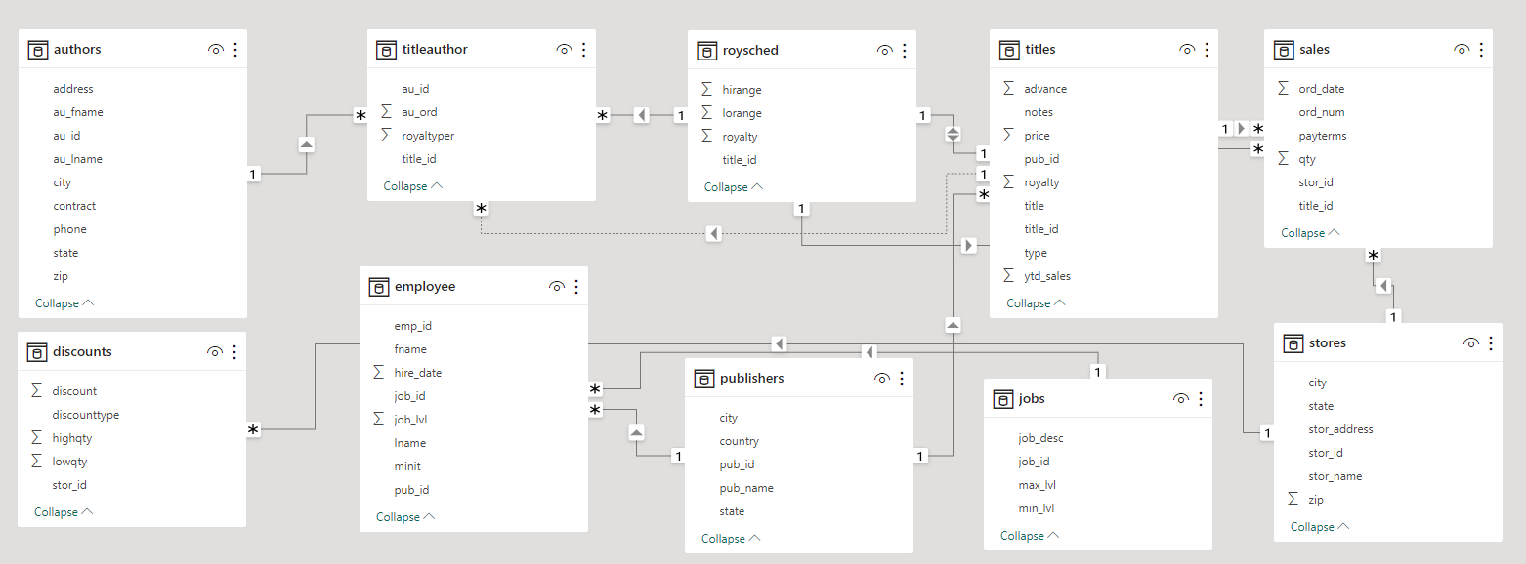
ER Diagram
Notes:
Now that we have comprehended the problem statement and recognized the significance of the project, let's delve into a thorough understanding of the dataset.
The Entity-Relationship (ER) diagram for the Power BI Dashboard using the above database represents the relationships and interactions between various entities (tables) in the database. Here's an explanation of the ER diagram based on the provided tables:
Entities:
Authors: Represents individual authors who contribute to the books published by the company. Each author is identified by a unique author ID and contains attributes such as author name and contact details.
TitleAuthor: This table establishes a many-to-many relationship between authors and book titles. It serves as a junction table, linking authors to the titles they have written or co-authored. It contains foreign keys for author ID and title ID.
RoySched: Stores information about the royalty payment schedules for authors based on book sales and other factors. It includes attributes like royalty schedule ID, payment terms, and percentage of royalties.
Titles: Contains details about book titles published by the company. Each title is identified by a unique title ID and includes attributes like book title, genre, publication date, and price.
Sales: Records sales transactions for each book title, including the date of sale, quantity sold, and revenue generated. It links to the Titles table using a foreign key for title ID.
Stores: Represents bookstores where the company's titles are available for purchase. Each store is identified by a unique store ID and contains attributes like store location and contact information.
Jobs: Stores employee job details within the publishing company, including job titles, job descriptions, and salaries. Each job is identified by a unique job ID.
Publishers: Holds data about publishers that collaborate with the company for book distribution. Each publisher is identified by a unique publisher ID and contains attributes like publisher name and contact details.
Employee: Represents employees working in the publishing company. Each employee is identified by a unique employee ID and contains attributes like employee name, job title (foreign key to Jobs table), and contact information.
Discounts: Records any special offers or discounts applicable to book sales. It includes attributes like discount type, discount value, and validity period.
The ER diagram visually presents the structure and relationships of the database, facilitating better understanding and design of the Power BI Dashboard. It provides a clear representation of data entities and their connections, enabling effective data analysis and visualization within the Power BI Dashboard.
I trust that you now have a clear understanding of the Capstone project requirements.

